Slide 1
Appearing for Interviews

Slide 2
Interviews Skills
1. Interviewing skills for Managers/Conducting interviews
2. Interview skills for an employee/Appearing for interviews

Slide 3
The Employment Interview
It is a meeting during which both you and the prospective employer ask questions and exchange information.
The employer’s objective is to find the best talent to fill available job openings, and
Your objective is to find the right match for your goals and capabilities.

Slide 4
Series or Sequence of Interviews
Match the following and also state which interview may happen first and so on.
Interview in the Series | Purpose
Selection Interview | To filter out candidates unqualified or not a good fit for the position
Screening Interview | To sell you on the advantages of the job, usually with a higher ranking executive
Final Evaluation Interview | Identifying the top candidates from all who qualify

Slide 5
Series or Sequence of Interviews
Refer to your handout and discuss the strategies you should use for each type of interview in the series.

Slide 6
Types of Employment Interviews
Refer to the handout and explain each type of the interview.
Structured vs unstructured
Panel vs group
Behavioral
Situational
Working
Stress

Slide 7
Types of Interviews-Summary
Structured vs Unstructured
A series of fixed questions vs open-ended questions molded as per the responses given
Panel vs group
Several interviewers in a panel vs a group discussion with other candidates
Behavioral
Questions about specific incidents/experiences from the past

Slide 8
Types of Interviews-Summary
Situational
Questions focus on how you will handle hypothetical situations on the job
Working
You are asked to perform a job related activity during the interview
Stress
To check how well you handle stressful situations. Designed to evaluate how you respond to hostility, terrible conditions, and to find out how you handle stress and pressure.

Slide 9
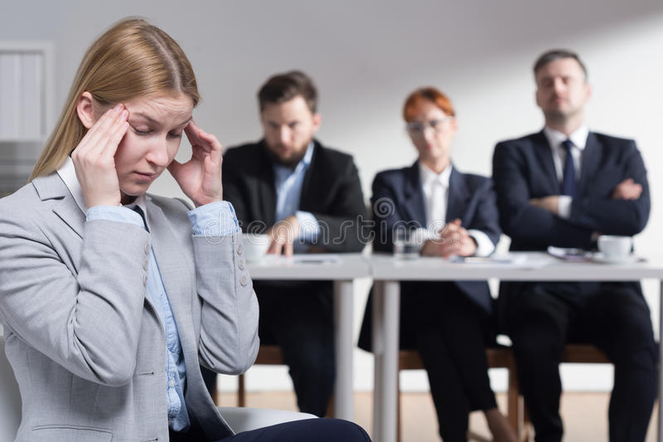
Stress Interviews...continued
Here, the interviewer(s):
Will glare at you, or fire questions that are rude, rapid pace.
Ridicules everything you say or challenges every answer.
Stares out the window and seems to be completely uninterested in anything you have to say.
These are deliberate tactics to subject you to stress.

Slide 10
Surviving stress interviews
Remain calm
keep a sense of humor
avoid getting angry or defensive.
It's a game to see if you will become depressed, hostile, or upset when facing adversity.

Slide 11
Distant- Interview Media
Telephonic
Video conference
Recorded
Mobile Apps

Slide 12
What does the Employer look for in the interview?
Think and Share or go through the handout.

Slide 13
What does the Employer look for in the interview? The purpose of interview.
Can you handle the responsibilities of the position?
Are you a good fit with the organization and the target position?
Do you have the qualities of a good employee-work ethic, confidence, dedication, positivity, courtesy, commitment, curiosity?
Can you commit to something larger than your own individual goals?
Are a good fit with the unique culture of the organization?

Slide 14
Interview Skills for an Employee
Employer’s objective is to find the best person for the job
Employer: reviews candidate’s experience and abilities
Can you do the job? (skills, abilities, qualifications)
Will you do the job? (interest, attitude & motivation)
How will you fit into the organisation? (personality)
You: impress employer and assess position on offer
What does this position offer me?
How does it fit with my career plans?

Slide 15
Stages of an Interview
There are three stages:
Before the interview
During the interview
After the interview

Slide 16
BEFORE-Preparation is the key to success
Review own skills, experiences and qualities
Check CV
Anticipate questions and identify relevant examples
Prepare key selling points
Know your Knowledge, Skills, Abilities and Accomplishments
Research organisation
Websites, reports, articles, company literature, etc
Contacts with knowledge of organisation or sector
Relevant articles in the press
Personal visit or telephone call
Research job and occupational area
Job description
Current issues
Prepare your questions
Practice

Slide 17
During the Interview
RELAX!
Answer the questions using the “PROVE IT” Method
Ask intelligent questions about the organization
Don’t volunteer negative information about yourself
Be honest
Have eye contact with the interviewer
Be believable, be yourself
Say positive things about your former supervisors and working conditions
Find ways to let the interviewer know you are a team player

Slide 18
The PROVE IT method: P-Preview the questions. R-Read the question/passage carefully. O-Omit wrong and impossible answers. V-Verify facts or clues E-Explain I-Infer answers that are not directly given. (Use the clues) T-Test your answer. Does it make sense?

Slide 19
After the Interview
Evaluate the interview
Write a thank you note to the interviewer
Follow up
Contact the interviewer for feedback
Express your interest in the position even after the position is filled

Slide 20
Watch the Body Language
First impressions very powerful
Allow time to relax
Dress appropriately
Entrance, introductions & handshake
Smile and make eye contact
Be aware of own movements
Watch body language of interviewer

Slide 21
Typical Questions
About you
Tell me about yourself - yourself, experience, interest, personality?
Why did you choose that particular degree programme?
What experience have you had that is relevant to this post?
What would you consider your major achievements to date?
About the job
What interests you about this job?
What do you know about this organisation?
What other options are you considering?
How do you see your career developing – 5 years?
If you were Head of Department, what would be your priorities?
General knowledge
What do you think of the Government’s policy on college fees?
What’s your opinion about the org.?

Slide 22
Other Type of Questions
“What if” Questions
No experience - how are you likely to respond to a situation
Probing Questions
How exactly did you deal with the situation?
How did you know it worked?
How did you feel about the outcome?
Could you have handled it differently?

Slide 23
Competency-based Interviews
On key skills required for job, questions are designed to elicit evidence of skills and emphasis on past behaviour as predictor of success.
NEEDED SKILLS AND TECHNIQUES TO BE UTILIZED
Teamwork: Describe a team project you worked on. What problems arose? How did you deal with them?
Communication Skills: Describe situation when you had to persuade others to support your view. Give an example of any reports you’ve written which illustrate your writing skills
Interpersonal skills: What kinds of people do you find it difficult to work with? How do you handle those situations?
Taking Responsibility: Describe a time when you took responsibility to achieve a challenging goal
Problem-solving: Tell about a time when you had several tasks to manage at one time with conflicting deadlines.

Slide 24
Preparing for Competency/problem tasks
Identify the competencies required for job
Prepare examples from past experience for each competency
Try to give a complete answer – Use STAR modal.
STAR response
S: Describe the situation
T: Explain the task/problem that arose
A: What action did you take?
R: What was the result or outcome?
What did you learn from this experience
Sample question:
Give me an example of a problem you encountered. How did you approach it. What was the outcome?

Slide 25
Matching Skills to Requirements
Employer needs | Your evidence/examples
Communication Team work Leadership Initiative Customer Care IT Commercial awareness | Presentation to class Example of any project Students societies, Committees etc. Fundraising for charity Working in some service. Designed website Business pages

Slide 26
How to Answer
Listen carefully, seek clarification
Illustrate answers with real examples and evidence
Be positive – constructive criticism
Keep answers specific and succinct
Take time to respond
Be alert to interviewer’s body language
Speak clearly, smile and show enthusiasm
Know what you want to say, and find the opportunity

Slide 27
Qualities Employers Seek
Good all-round intelligence
Enthusiasm, commitment and motivation
Good communication skills
Team work ability
Ability to solve problems
Capacity to work hard
Initiative and self-reliance
Balanced personality

Slide 28
Questions be based on:
Training programmes
Career development opportunities
Types of projects & responsibilities
Reporting structure
Performance appraisal
Profile of staff
Questions about topics raised in interview
What happens next?

Slide 29
What creates a bad impression
Poor personal appearance
Negative attitude – evasive, using excuses
Lack of interest and enthusiasm
Lack of preparation
Poor knowledge of role
Failure to give concrete examples of skills
Over emphasis on money/rewards
Lack of career plan

Slide 30
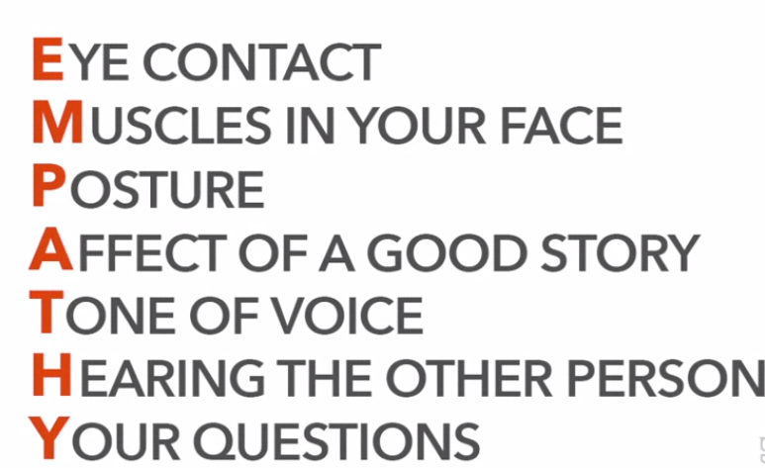
ESTABLISHING THE FIRST GREAT IMPRESSION
To make a great first impression, use your EMPATHY skills.

Slide 31
E-EYE-CONTACT, Firm Handshake
M-MUSCLES IN YOUR FACE: During a job interview, we need to be upbeat/cheerful, interested and interesting and likable. Facial expressions, smile.
P-POSTURE: Includes the body posture, our hand gestures, eye movement and the use of space.
A-AFFECT OF A GOOD STORY: Stories are a universal language of thoughts, feelings and hopes.
Develop such a personal story that can give a sense of commonality and community.
T-TONE OF VOICE: be confident, speak at the right normal pitch and speed for the situation.
H-HEARING THE OTHER PERSON: Practice, hear and understand the other person.
Y-YOUR QUESTIONS: a couple of critical questions develop strong first impression.
Sample question :
I see that your company has five core values (repeat them). As you look at the company's future, which core value do you think is most important?

Slide 32
PROMOTE YOURSELF
Four Components to Promote Yourself
Know your intentions - what you want and don’t want, and what you will and will not share.
Promote what you believe in and own it- Introduce yourself, Share examples, show your passion, translate the difference you have made, and most importantly focus on for whom.
State the Value Proposition First- “what’s in it for me”. Give solutions to problems, benefits organization, and/or for truly interesting information that adds value to their knowledge base
Be Yourself- don’t “fake it ‘till you make it”. If you’re not naturally loud and outgoing, don’t try to be. Quiet is just as good.

Slide 33
TOP 10 MOST WANTED SKILLS IN INTERVIEW
10. Problem Solving Skills: Employers want to know you can make decisions. You can solve problems.
9. Planning and Organization: You know how to plan and organize your time. Managers want to know you can set goals and reach them.
8. Flexibility and Adaptability: Organizations expect you to be flexible and adaptable. You can manage multiple assignments and tasks, you can set priorities, you can adapt to changing conditions, and work assignments.
7. Interpersonal Skills: You have good interpersonal skills, you have a high emotional IQ, you know how to get along with others, and minimize conflict. Employers want to know you can relate to other people and cultures with sensitivity and awareness.
6. Strength of Character: you are honest, you have integrity, loyalty, strength of character. Your supervisor certainly expects you to be trustworthy and honest.

Slide 34
TOP 10 MOST WANTED SKILLS IN INTERVIEW
5. Technical Skills: you have the skills you need to actually perform your work. Firms want you to know you have the skill set to do the job, of course. But that's not all.
4. Teamwork: You can work confidently within a group., You let your voice be heard and respect what others have to say. Because so many jobs involve working in groups, employers want you to be able to work well with others. To fit in with the team.
3. Self-Motivation: You are a self motivated person, you take initiative, you work hard. Organizations don't want people who always have to be told what to do. They want you to take responsibility for your work.
2. Evolutionary Skills: You know how to learn, and how to continually improve. Every potential employer wants to know you can grow and evolve in your work. And now the number one skill that employers are looking for.
1. Communication Skills: you are a clear, concise, and effective communicator. Employers want you to be able to speak and listen effectively.

Slide 35
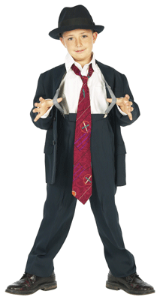
For Men
Belt should match shoes!
Hair well-groomed
Conservative watch and other jewelry
Removing earrings is safest
Do not leave the tags on outside of apparel
Long socks to match color of suit – no white tube socks!

Slide 36
For Women
Decent and modest dressing
Business colors for Shirts-blue, grey, white, beige, earthly tones
Trousers/Stolers-black, white, off-white, beige
Formal jewelry (one ring/bracelet, small earrings, no necklace/chain) and watch
Hair-well-put together (no complicated styling)

Slide 37


For Everyone
Hair should be neat and clean
Shoes should be in good condition
Clean fingernails
Clothes should fit properly
Use appropriate deodorant
Details
Everything clean and well-pressed
Slim leather briefcase if needed

Slide 38
Assignment considered as quiz. A mock interview form will be shared. Individually, fill the form using the knowledge of job interview skills and submit it online. Submission date: 3rd May 2021. Save file with: SEC-ROLL#-Q3 I.E. C-K20-1234-Q3

